Slide 1
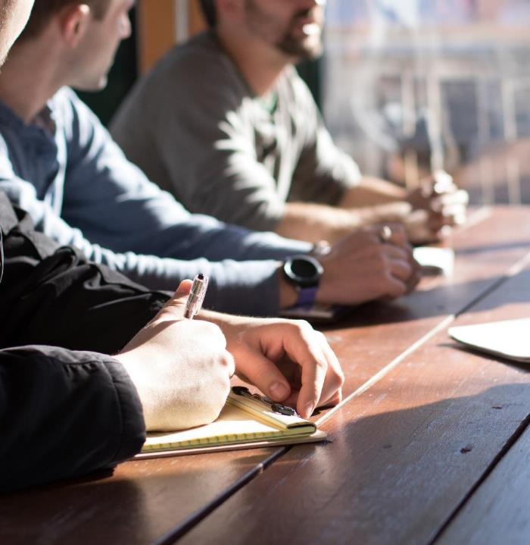
1811’s ideas
Phone applications

Slide 2

This Photo by Unknown Author is licensed under CC BY-SA-NC

Slide 3
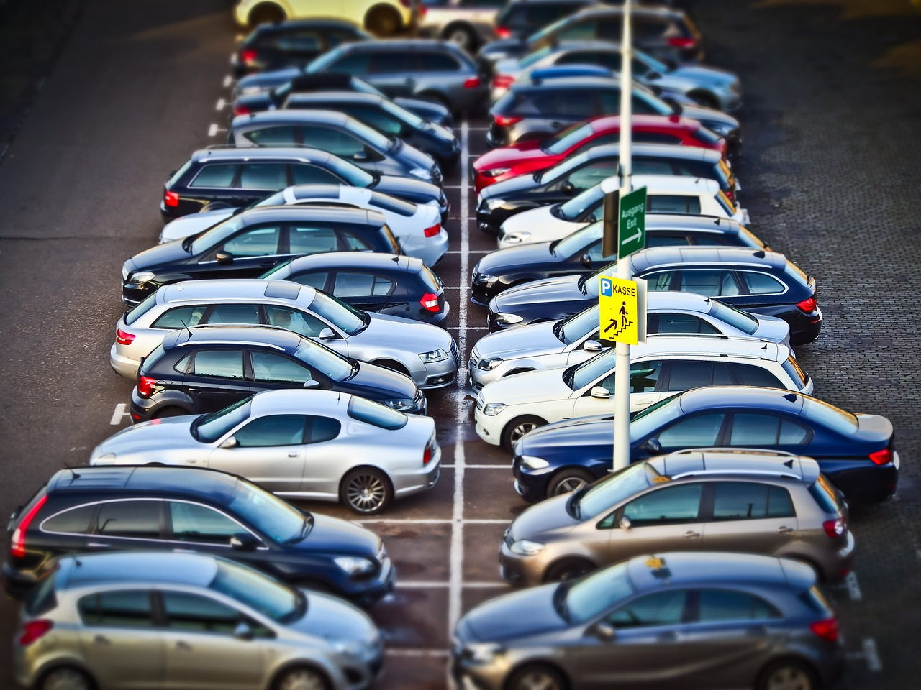
Parker
This application will be a tool to making a driver’s stress on looking for a slot stress and worry free.
This Photo by Unknown Author is licensed under CC BY-ND

Slide 4
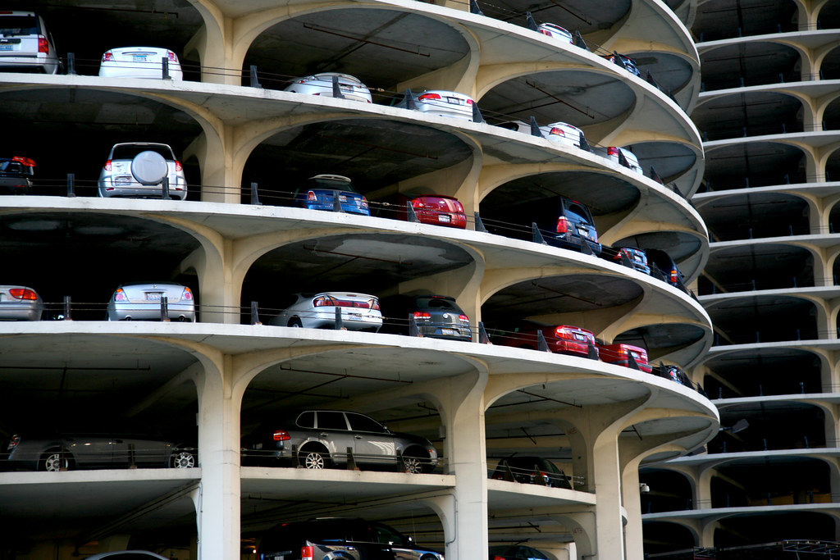
“Parker” will be able to do the following:
Make Reservations
Paying parking fees online
Show availability of parking slots on buildings
This Photo by Unknown Author is licensed under CC BY

Slide 5



Slide 6
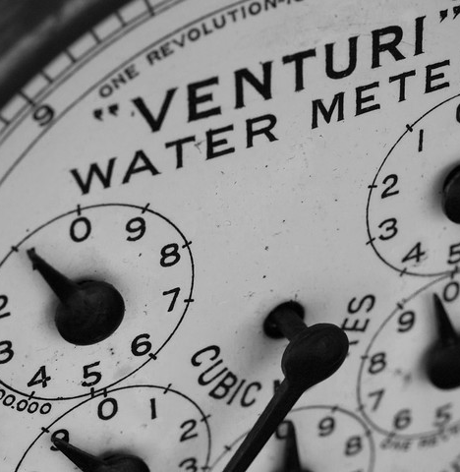
Water Watcher
This application will be a tool to watch over your water consumption on your phone.
This Photo by Unknown Author is licensed under CC BY
This Photo by Unknown Author is licensed under CC BY-ND

Slide 7

“Water Watcher” will be able to do the following:
Notify the user when water is being consumed extensively.
Show current bill.
This Photo by Unknown Author is licensed under CC BY-SA
This Photo by Unknown Author is licensed under CC BY

Slide 8

This Photo by Unknown Author is licensed under CC BY-SA

Slide 9

JJC.ph
This application will be a tool to watch and register on fights.
This Photo by Unknown Author is licensed under CC BY-NC-ND
This Photo by Unknown Author is licensed under CC BY
This Photo by Unknown Author is licensed under CC BY-ND

Slide 10
“JJC.PH” will be able to do the following:
Register on Fights with ease.
Pay online through the app.
Show details of events
Location
Time
Brackets
This Photo by Unknown Author is licensed under CC BY-SA
This Photo by Unknown Author is licensed under CC BY

